Slide 1
















Chapter 5: Divide and Conquer
Heap Sort
DESIGN & ANALYSIS OF ALGORITHM (BCSC0012)
Input
Algorithm
Output

Slide 2
Special Types of Trees
4
Def: Full binary tree = a binary tree in
which each node is either a leaf or has degree exactly 2.
1
3
16 9
12
2
10
14
8 7
Full binary tree
4
Def: Complete binary tree = a binary tree in which all leaves are on the same level and all internal nodes have degree 2.
1
3
2
16 9
10
Complete binary tree

Slide 3
Special Types of Trees
Height of a node = the number of edges on the longest simple path from the node down to a leaf
Level of a node = the length of a path from the root to the node
Height of tree = height of root node
4
Height of root = 3
1
3
Height of (2)= 1
2
16 9
10
Level of (10)= 2
14
8

Slide 4
The Heap Data Structure
Def: A heap is a nearly complete binary tree with the following two properties:
Structural property (shape property) : A Heap tree is essentially complete (or simply complete), i.e., all its levels are full except possibly the last level, where only some rightmost leaves may be missing.
Order (heap) property: for any node x,
Parent(x) ≥ x (MaxHeap)
8
7
4
From the heap property, it follows that:
“The root is the maximum element of the heap!”
5
2
Heap
A heap is a binary tree that is filled in order

Slide 5
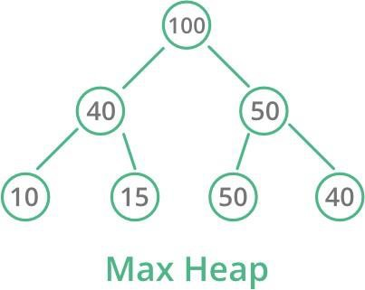
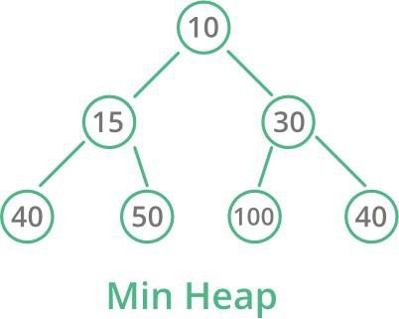
Heap Types
Max-heaps (largest element at root), have the
max-heap property:
for all nodes i, excluding the root:
A[PARENT(i)] ≥ A[i]
Min-heaps (smallest element at root), have the
min-heap property:
for all nodes i, excluding the root:
A[PARENT(i)] ≤ A[i]

Slide 6
Heap Tree
Illustration of the definition of heap

Slide 7
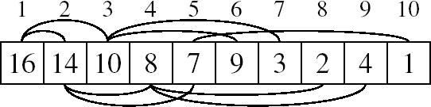
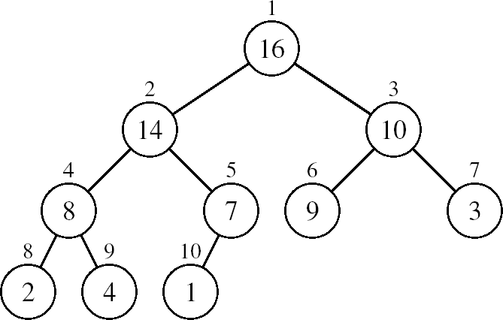
Array Representation of Heaps
A heap can be stored as an array A.
Root of tree is A[1]
Left child of A[i] = A[2i]
Right child of A[i] = A[2i + 1]
Parent of A[i] = A[ ⎣i/2⎦ ]
Heapsize[A] ≤ length[A]
The elements in the subarray A[(⎣n/2⎦+1) .. n] are leaves

Slide 8
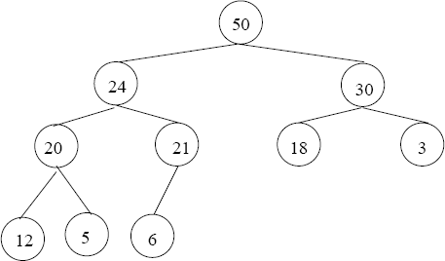
Adding/Deleting Nodes
New nodes are always inserted at the bottom level (left to right)
Nodes are removed from the bottom level (right to left)

Slide 9
Operations on Heaps
Maintain/Restore the max-heap property
MAX-HEAPIFY
Create a max-heap from an unordered array
BUILD-MAX-HEAP
Sort an array in place
HEAPSORT
Priority queues

Slide 10
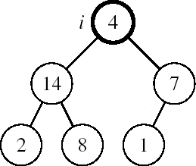
Maintaining the Heap Property
Suppose a node is smaller than a child
Left and Right subtrees of i are max- heaps
To eliminate the violation:
Exchange with larger child
Move down the tree
Continue until node is not smaller than children

Slide 11
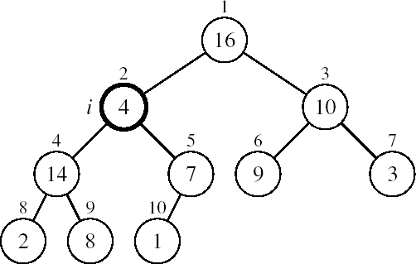
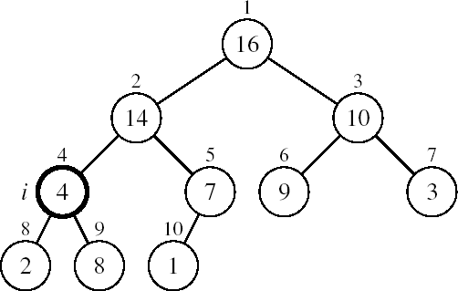
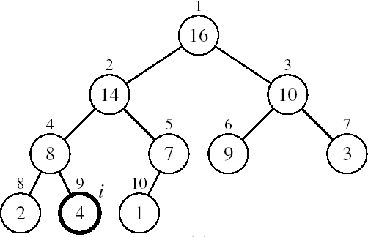
Example
MAX-HEAPIFY(A, 2, 10)
A[2] ↔ A[4]
A[2] violates the heap property
A[4] violates the heap property
A[4] ↔ A[9]
Heap property restored

Slide 12
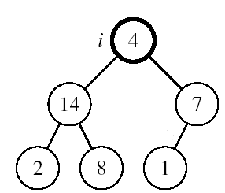
Maintaining the Heap Property
Assumptions:
Alg: MAX-HEAPIFY(A, i, n)
l ← LEFT(i)
r ← RIGHT(i)
Left and Right subtrees of i are max-heaps
A[i] may be smaller than its children
if l ≤ n and A[l] > A[i]
then largest ←l
5. Else
largest ←i;
if r ≤ n and A[r] > A[largest]
then largest ←r
if largest ≠ i
then exchange A[i] ↔ A[largest]
MAX-HEAPIFY(A, largest, n)

Slide 13
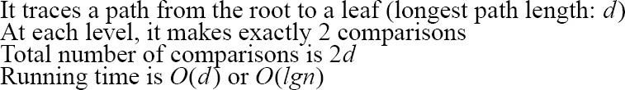
MAX-HEAPIFY Running Time
Intuitively:
-
h
-
-
-
2h
O(h)
Running time of MAX-HEAPIFY is O(lgn)
Can be written in terms of the height of the heap, as being O(h)
– Since the height of the heap is ⎣lgn⎦
12

Slide 14
Building a Heap
Convert an array A[1 … n] into a max-heap (n = length[A])
The elements in the subarray A[(⎣n/2⎦+1) .. n] are leaves
Apply MAX-HEAPIFY on elements between 1 and ⎣n/2⎦
Alg: BUILD-MAX-HEAP(A)
n = length[A]
for i ← ⎣n/2⎦ downto 1
3.
1
4
2
1
3
3
4
6
16 9
7
10
do MAX-HEAPIFY(A, i, n)
5
2
8
14
9 10
8 7
A:
4 | 1 | 3 | 2 | 16 | 9 | 10 | 14 | 8 | 7

Slide 15
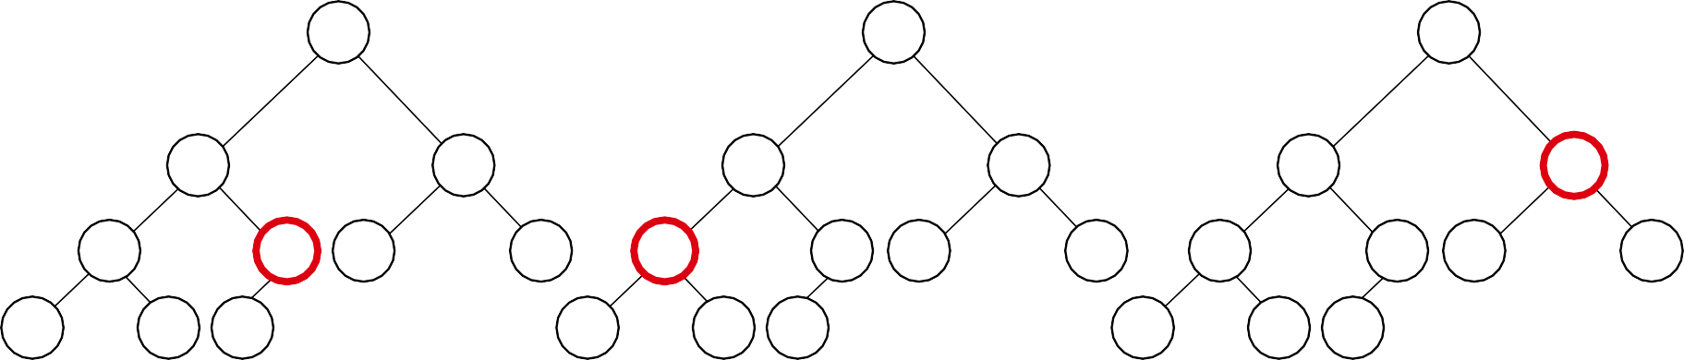
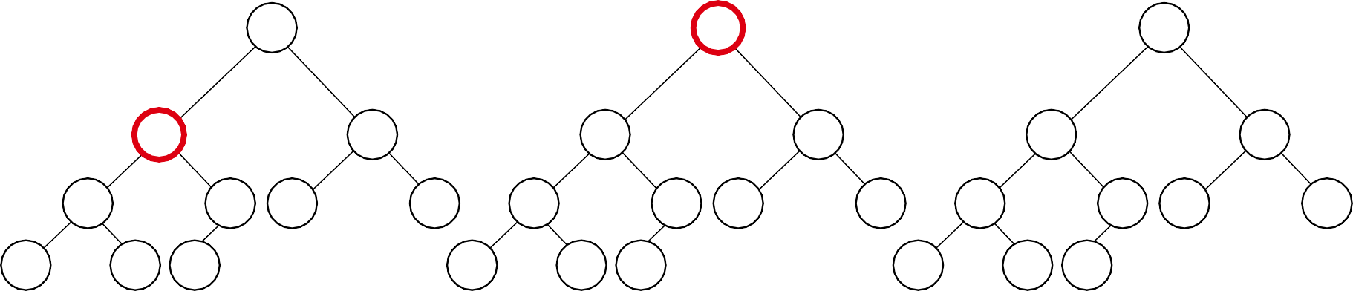
Example:
A
4 | 1 | 3 | 2 | 16 | 9 | 10 | 14 | 8 | 7
i = 5
1
4
i = 4
1
4
i = 3
1
4
2
1
3
3
2
1
3
3
2
1
3
3
 | 4 | 5 | 6 | 7 | 4 | 5 | 6 | 7 | 4
8 | 2 ₉ | ₁₀ 16 | 9 | 10 ₈ | 2 ₉ | ₁₀ 16 | 9 | 10 ₈ | 14 | 9 | 10
14 | 8 | 7 |  | 14 | 8 | 7 |  | 2 |  | 8 | 7
5 6
16 9
7
10
i = 2
1
4
i = 1
1
4
1
16
2
1
3
10
2
16
3
10
2
14
3
10
 | 4 | 5 | 6 | 7 | 4 | 5 | 6 | 7 | 4
8 | 14 ₉ | ₁₀ 16 | 9 | 3 ₈ | 14 ₉ | 10 ⁷ | 9 | 3 ₈ | 8 | 9 | 10
2 | 8 | 7 |  | 2 | 8 | 1 |  | 2 |  | 4 | 1
5 6
7 9
7
3

Slide 16
Running Time of BUILD MAX HEAP
Alg: BUILD-MAX-HEAP(A)
n = length[A]
for i ← ⎣n/2⎦ downto 1
do MAX-HEAPIFY(A, i, n)
O(n)
O(lgn)
⇒ Running time: O(nlgn)
This is not an asymptotically tight upper bound

Slide 17
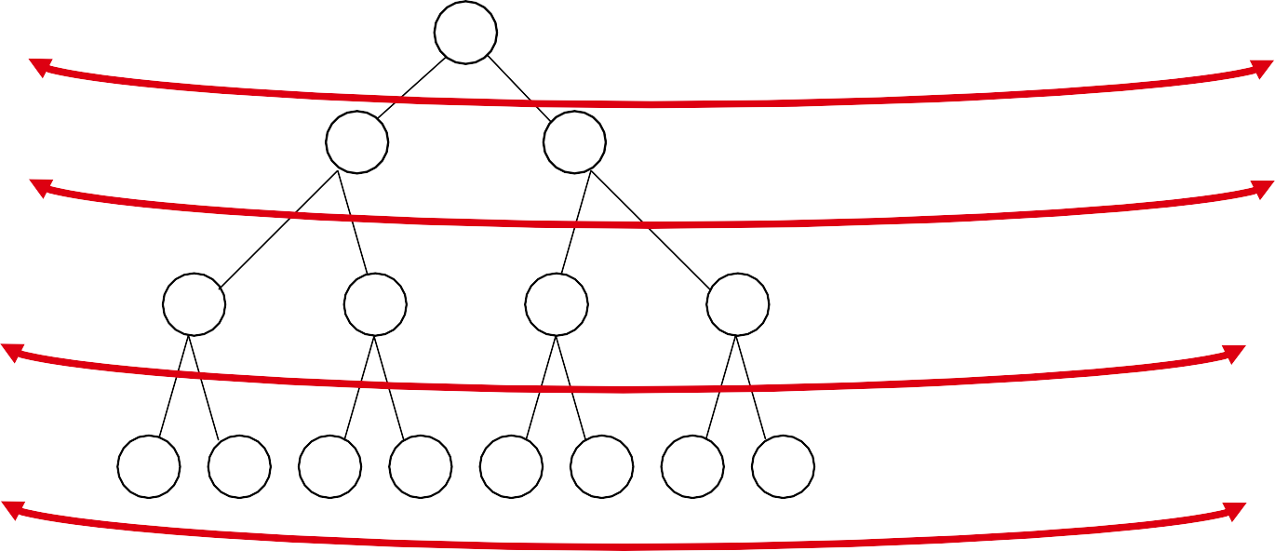
Running Time of BUILD MAX HEAP
HEAPIFY takes O(h) ⇒ the cost of HEAPIFY on a node i is
proportional to the height of the node i in the tree
⇒ T (n) = ∑ n_{i} h_{i} =
i=0
h
h
∑
i=0
2 (h − i) = O(n)
i
Height
Level No. of nodes
h₀ = 3 (⎣lgn⎦)
i = 0
₂0
h₁ = 2
i = 1
₂1
h₂ = 1
i = 2
₂2
h₃ = 0
i = 3 (⎣lgn⎦)
₂3
h_{i} = h – i
n_{i} = 2^{i}
height of the heap rooted at level i
number of nodes at level i

Slide 18
Running Time of BUILD MAX HEAP
T (n) = ∑ n_{i}h_{i}
i=0
h
h
Cost of HEAPIFY at level i ∗ number of nodes at that level
= ∑ 2^{i} (h − i)
i=0
h
Replace the values of n_{i} and h_{i} computed before
= ∑
h − i
₂h−i
₂h
Multiply by 2^{h} both at the nominator and denominator and
write 2^{i} as
1
₂−i
i=0
h
k
₂k
= 2^{h} ∑
Change variables: k = h - i
k =0
∞
k
≤ n∑
The sum above is smaller than the sum of all elements to ∞
and h = lgn
k =0 2
k
= O(n)
The sum above is smaller than 2
Running time of BUILD-MAX-HEAP: T(n) = O(n)

Slide 19
Heapsort
Heapsort—an interesting sorting algorithm discovered by J. W. J. Williams. This is a two-stage algorithm that works as follows.
Stage 1 (heap construction): Construct a heap for a given array.
Stage 2 (maximum deletions): Apply the root-deletion operation n − 1 times to the remaining heap.

Slide 20
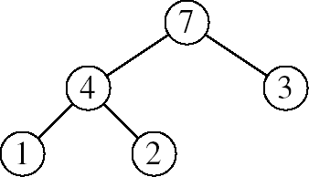
Heapsort
Goal:
Sort an array using heap representations
Idea:
Build a max-heap from the array
Swap the root (the maximum element) with the last element in the array
“Discard” this last node by decreasing the heap size
Call MAX-HEAPIFY on the new root
Repeat this process until only one node remains

Slide 21
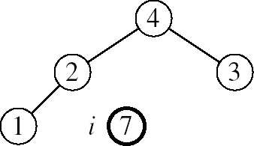
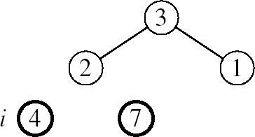
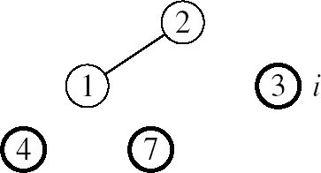
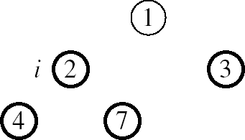

Heapsort …
Example:
A=[7, 4, 3, 1, 2]
MAX-HEAPIFY(A, 1, 4)
MAX-HEAPIFY(A, 1, 3)
MAX-HEAPIFY(A, 1, 2)
MAX-HEAPIFY(A, 1, 1)

Slide 22
Heapsort …
BUILD-MAX-HEAP(A)
for i ← length[A] downto 2
do exchange A[1] ↔ A[i]
MAX-HEAPIFY(A, 1, i - 1)
O(n)
n-1 times
O(lgn)
Running time: O(nlgn) --- Can be shown to be Θ(nlgn)

Slide 23
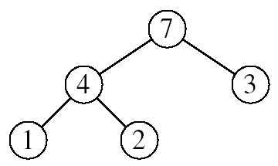
Heapsort : HEAP-EXTRACT-MAX
Goal:
Extract the largest element of the heap (i.e., return the max value and
also remove that element from the heap
Idea:
Exchange the root element with the last
Decrease the size of the heap by 1 element
Call MAX-HEAPIFY on the new root, on a heap of size n-1
Heap A:
Root is the largest element

Slide 24
Heapsort : HEAP-EXTRACT-MAX …
16
1
14
10
max = 16
14
10
8
7 9
3
8
7 9
3
2
4 1
2 4
Heap size decreased with 1
14
Call MAX-HEAPIFY(A, 1, n-1)
8
10
4
7 9
3
2
1

Slide 25
Heapsort : HEAP-EXTRACT-MAX …
Alg: HEAP-EXTRACT-MAX(A, n)
if n < 1
then error “heap underflow”
max ← A[1]
A[1] ← A[n]
MAX-HEAPIFY(A, 1, n-1)
return max
Running time: O(lgn)
remakes heap

Slide 26
Heapsort
We can perform the following operations on heaps:
MAX-HEAPIFY
BUILD-MAX-HEAP
HEAP-SORT
MAX-HEAP-INSERT
HEAP-EXTRACT-MAX
HEAP-INCREASE-KEY
HEAP-MAXIMUM
O(lgn)
O(n)
O(nlgn)
O(lgn)
O(lgn)
O(lgn)
O(1)
Average
O(lgn)

